Slide 1
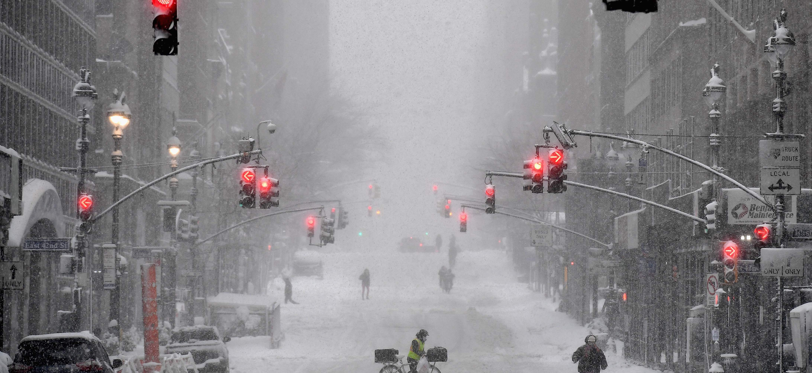
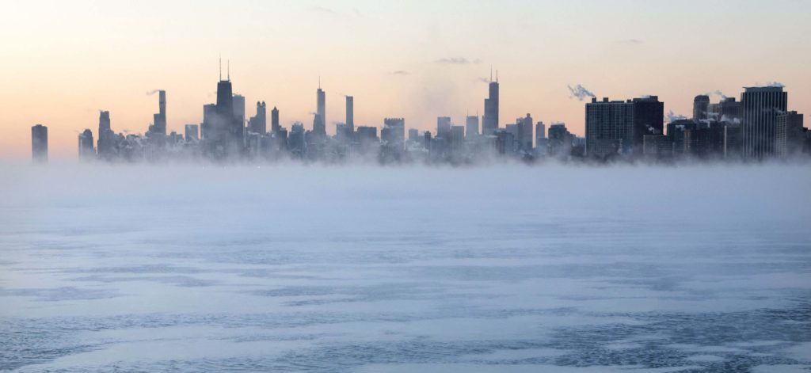
Extreme cold waves related deaths : Which evolution ?
Occupational and Environmental Health
Luo Mingyang, Adèle Soulier, Léo Stähli
Notes:
LEO

Slide 2
Presentation outline
Hazard identification
Hazards present in the situation and health risks
Background information
Specific context of this situation, protective and aggravating factors
Risk assessment
High or low risk, accidents and illnesses
Relevant regulation
Legal provisions or rules of good practice
Recommendations
Prevention and protection measures
Notes:
LEO

Slide 3
Hazard identification
Notes:
LEO

Slide 4
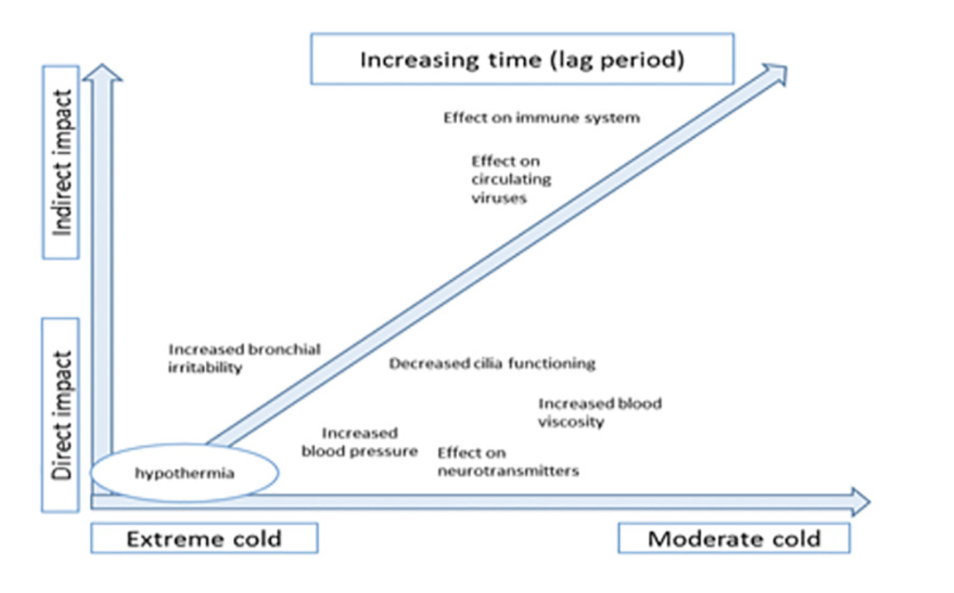
Hazard identification - Background information – Risk assessment – Relevant regulation - Recommendations
What are the effects of cold exposure ?
What is cold-related mortality? A multi-disciplinary perspective to inform climate change impact assessments, Arbuthnott et al. 2018
Notes:
Effects of Cold Exposure vary depending on the intensity and duration of exposure

Slide 5
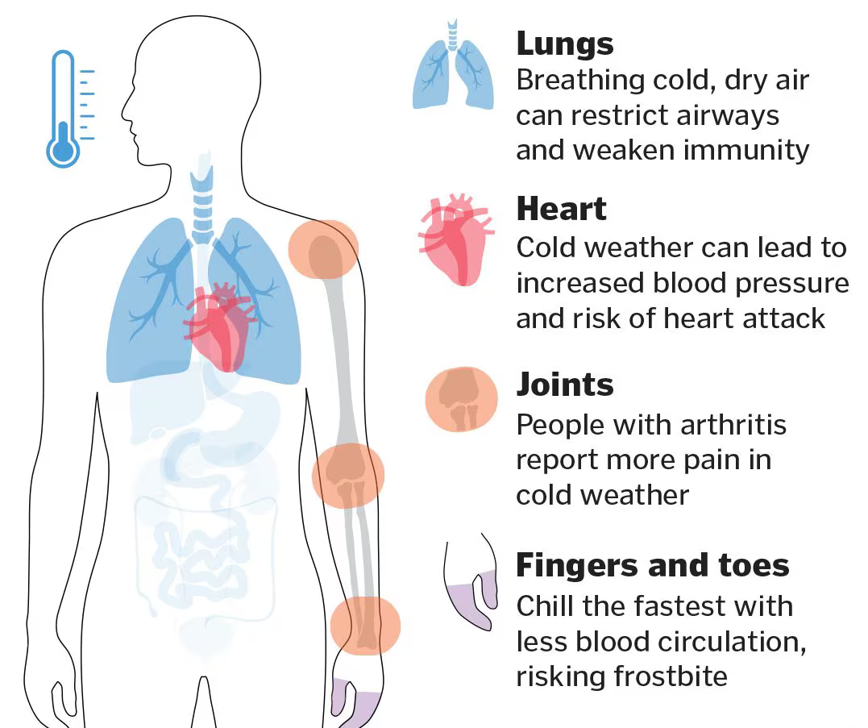
Hazard identification - Background information – Risk assessment – Relevant regulation - Recommendations
What are the effects of cold exposure ?
Respiratory issues
Cardiovascular problems
Frostbite
Hypothermia
Cold exposure can be the underlying cause of death or by aggravating a preexisting condition, it can be a contributing cause of death
Source: https://www.bostonglobe.com
Notes:
LEO

Slide 6
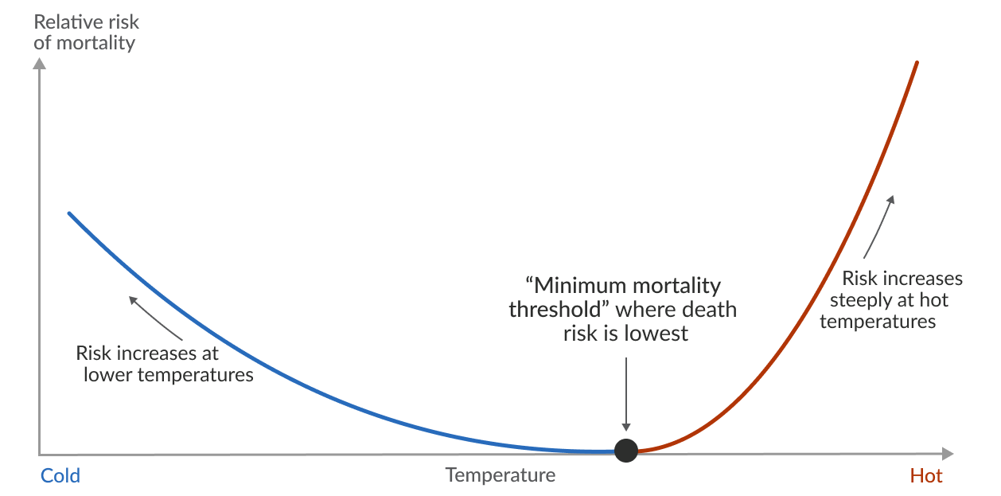
Hazard identification - Background information – Risk assessment – Relevant regulation - Recommendations
How are death by cold exposure studied ?
Rare “death by cold” diagnostic
➔ Cold wave related death have to be studied from an epidemiological point of view
Observation of excess death rates
= Comparing death rates between a normal period vs. cold or hot period
Temperature-mortality relationship
for hot or cold waves
Hannah Ritchie (2024)
Notes:
LEO

Slide 7
Background information
Notes:
ADELE

Slide 8
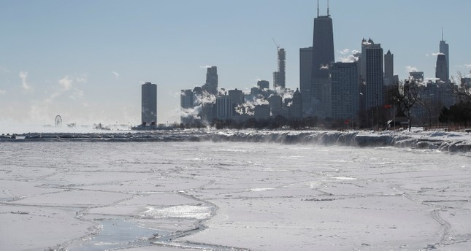
Hazard identification - Background information – Risk assessment – Relevant regulation - Recommendations
What's a cold Wave ?
US National Weather Service definition
Rapid fall in temperature within 24 hours
+
Extreme low temperatures for an extended period
World meteorological organization (WMO) definition
«period of marked and unusual cold weather characterised by a sharp and significant drop in temperatures (…) for at least two consecutive days during the cold season» (WMO,2020)
The rate of the temperature drop
The minimum temperature reached
➔ A cold wave is characterized by
Image :Mist rises from frozen Lake Michigan during one of the worst cold waves in Chicago, Illinois USA, 30 January 2019. (AFP Photo)
Notes:
ADELE

Slide 9
Hazard identification - Background information – Risk assessment – Relevant regulation - Recommendations
What's a cold Wave ?
US National Weather Service definition
Rapid fall in temperature within 24 hours
+
Extreme low temperatures for an extended period
World meteorological organization (WMO) definition
«period of marked and unusual cold weather characterised by a sharp and significant drop in temperatures (…) for at least two consecutive days during the cold season» (WMO,2020)
A cold wave is characterized by
Image :Mist rises from frozen Lake Michigan during one of the worst cold waves in Chicago, Illinois USA, 30 January 2019. (AFP Photo)

Slide 10
Hazard identification - Background information – Risk assessment – Relevant regulation - Recommendations
Cold Wave characterized by :
rate at which the temperature falls
+
the minimum to which it falls
Image :Mist rises from frozen Lake Michigan during one of the worst cold waves in Chicago, Illinois USA, 30 January 2019. (AFP Photo)

Slide 11
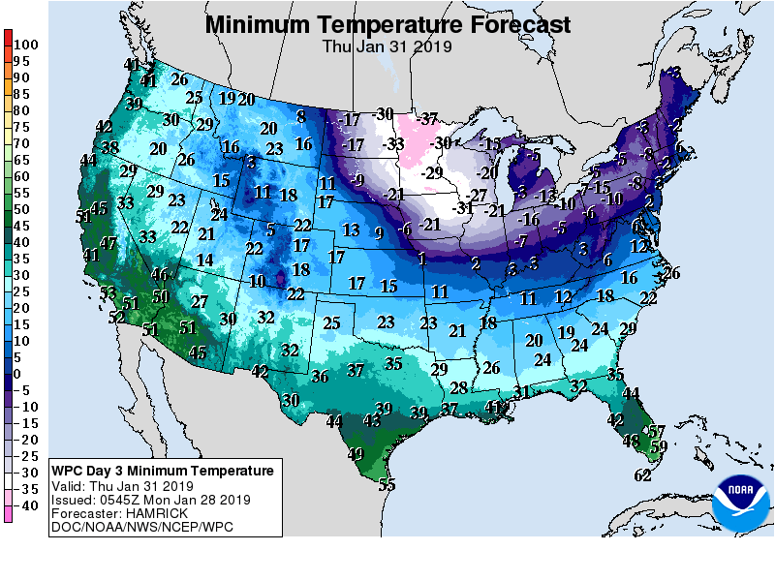
Hazard identification - Background information – Risk assessment – Relevant regulation - Recommendations
Temperatures classified as a cold wave :
depend on the location
and
the time of the year
taking the temperature difference from normal into account
EXTREME cold wave :
According to the CISA
Temperatures lower than historical averages to the point that it creates a dangerous environment for people and animals
Image : https://www.noaa.gov/
Notes:
ADELE

Slide 12
Hazard identification - Background information – Risk assessment – Relevant regulation - Recommendations
Temperatures classified as a cold wave :
depend on the location
+
the time of the year
(taking the temperature difference from normal into account)
Image : https://www.noaa.gov/
ThePhoto par PhotoAuthor est fournie sous licence CCYYSA.

Slide 13
Hazard identification - Background information – Risk assessment – Relevant regulation - Recommendations
C
EXTREME cold wave :
According to the CISA
Temperatures lower than historical averages to the point that it creates a dangerous environment for people and animals
Image : https://www.noaa.gov/
CISA = US Cybersecurity and Infrastructure security agency

Slide 14
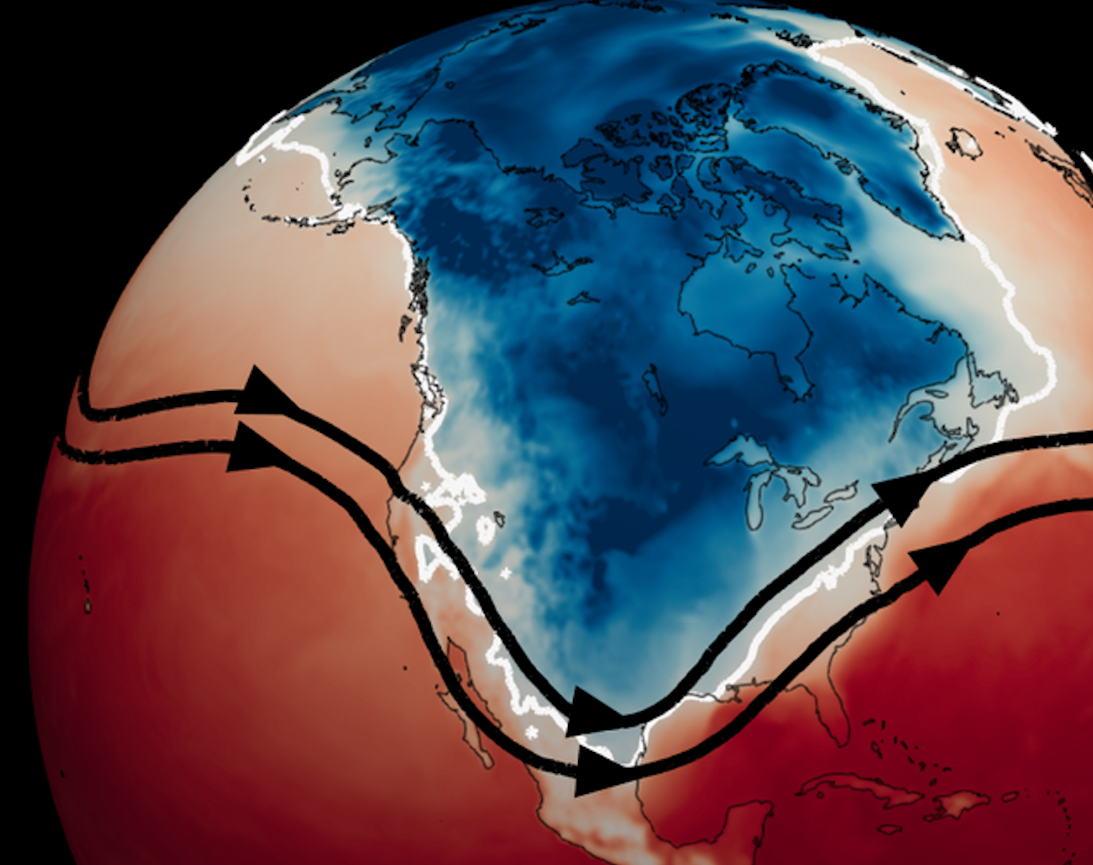
Hazard identification - Background information – Risk assessment – Relevant regulation - Recommendations
What causes a cold wave in USA:
Very cold, dense air moves from Arctic regions of northern Canada
Source : Cold Waves, Royal Meteorological Society
Image : Mathew Barlow/University of Massachusetts Lowell, CC BY-ND
Notes:
ADELE

Slide 15
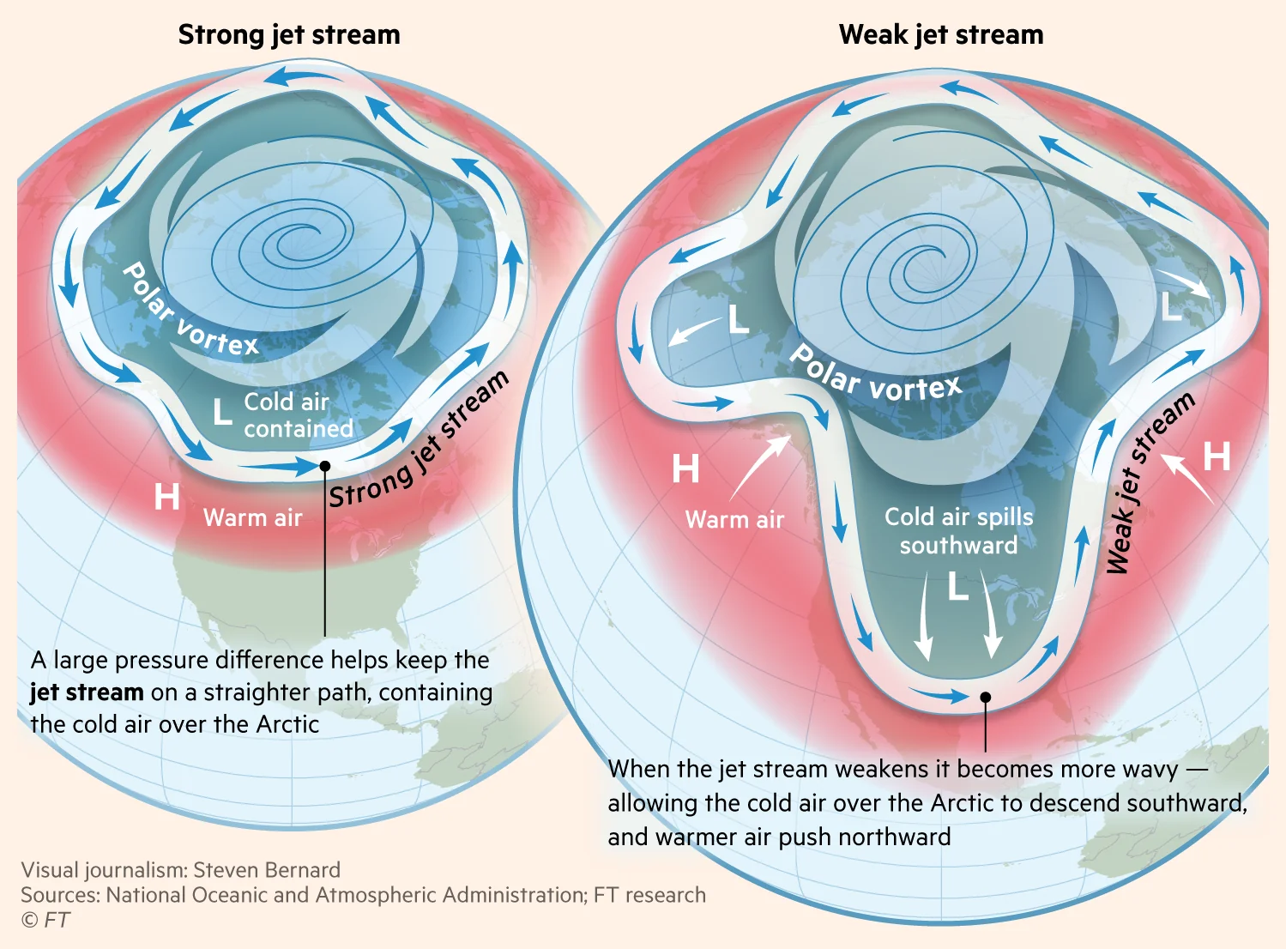
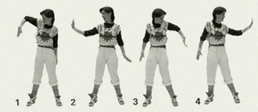
Hazard identification - Background information – Risk assessment – Relevant regulation - Recommendations
What causes a cold wave in USA:
A wavy jet stream !!!
Notes:
ADELE
The jet stream is a river of wind, flowing from the West to the East and encircling the Northern Hemisphere. It create a boundary between the cold Arctic air and the warmer air to the South. But, when it became wavy du to disruptions in the atmospheric circulation caused by many different factors, It extend farther to the North and the South, causing cold arctic air to descend.
The jet stream becomes wavy due to disruptions in the atmospheric circulation caused by various factors, including temperature differences the poles and the equator... DON'T GO IN DETAIL

Slide 16
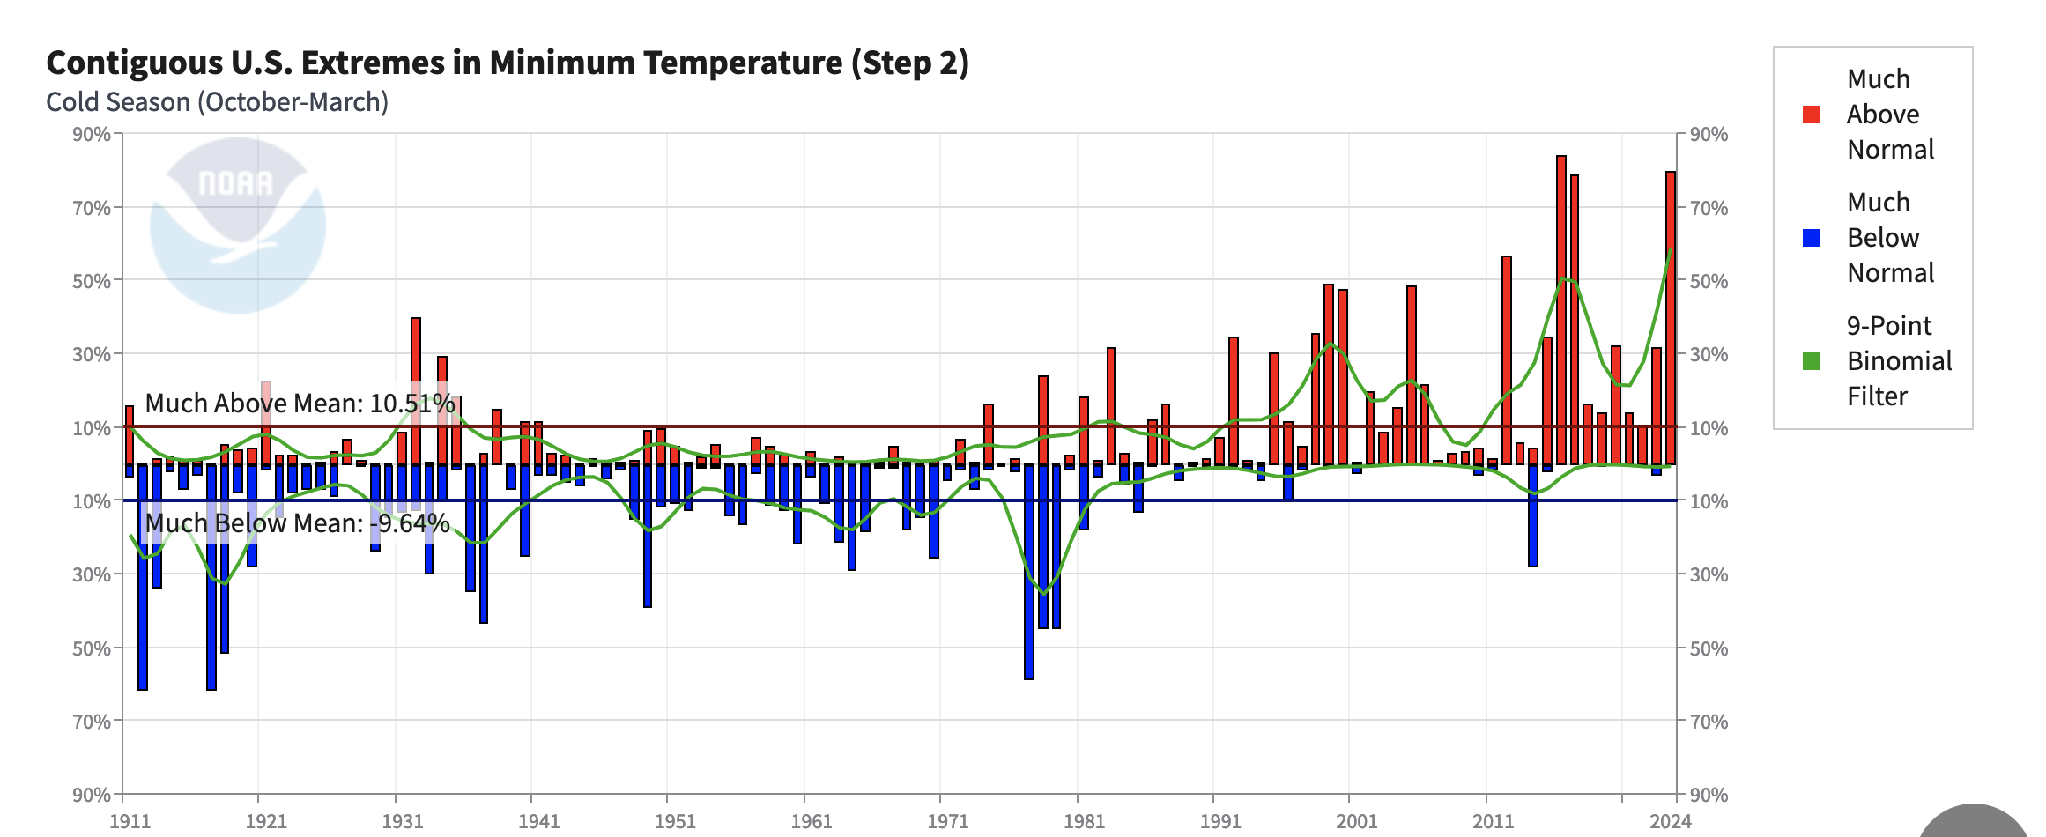
Hazard identification - Background information – Risk assessment – Relevant regulation - Recommendations
Observed disminution of extreme cold temperatures
Influence of climate change :
Notes:
ADELE
Yet, with the Arctic warming three times faster than the average for rest of the world, the temperature difference between North and South decreases and so does the speed of the jet stream’s westerly winds. As these winds slow down, its waves typically grow bigger and extend farther to the North and the South. Larger jet-stream waves move eastward more slowly, affecting weather patterns across North America to Central Europe and Asia.
Climate change is favorable for increasing Arctic polar vortex stretching events, according to the study.

Slide 17
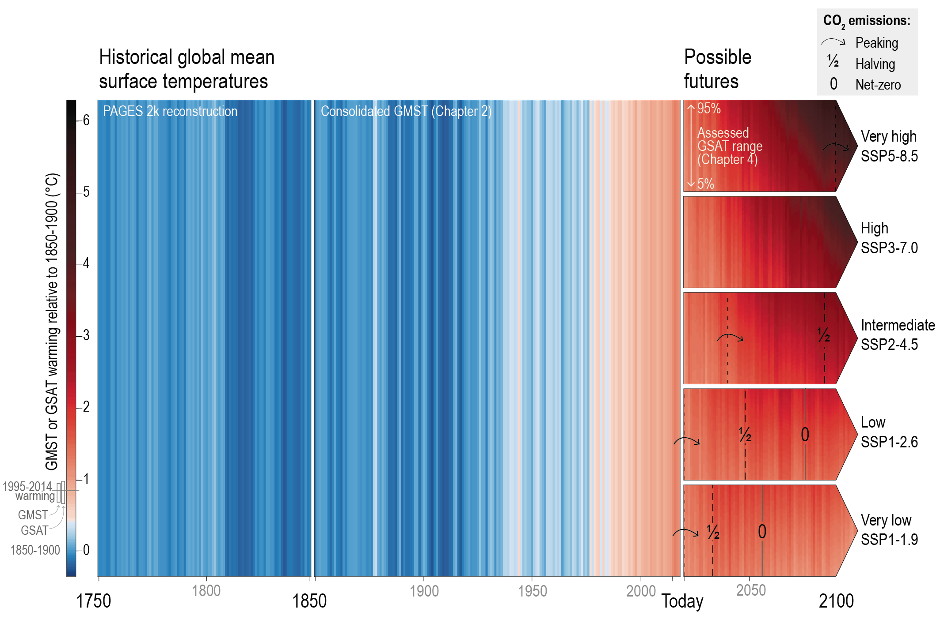

Hazard identification - Background information – Risk assessment – Relevant regulation - Recommendations
Influence of climate change :
Frequency and intensity of cold extremes will decrease at global and continental scales and in nearly all inhabited regions
Notes:
ADELE
Yet, with the Arctic warming three times faster than the average for rest of the world, the temperature difference between North and South decreases and so does the speed of the jet stream’s westerly winds. As these winds slow down, its waves typically grow bigger and extend farther to the North and the South. Larger jet-stream waves move eastward more slowly, affecting weather patterns across North America to Central Europe and Asia.
Climate change is favorable for increasing Arctic polar vortex stretching events, according to the study.

Slide 18
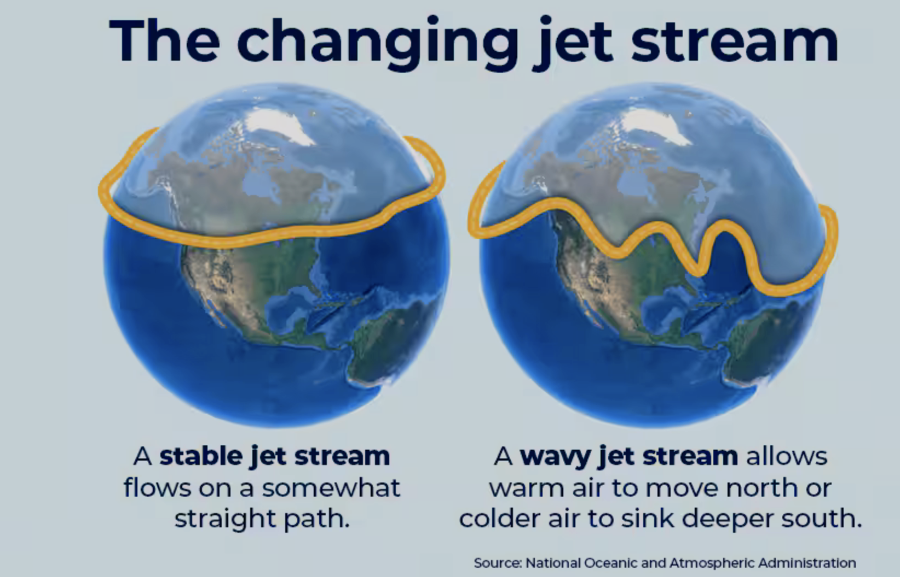
Hazard identification - Background information – Risk assessment – Relevant regulation - Recommendations
Influence of climate change :
-could increase cold wave frequency events
(Linking Arctic variability and change with extreme winter weather in the United States, Cohen et al., 2021)
Notes:
ADELE
Yet, with the Arctic warming three times faster than the average for rest of the world, the temperature difference between North and South decreases and so does the speed of the jet stream’s westerly winds. As these winds slow down, its waves typically grow bigger and extend farther to the North and the South. Larger jet-stream waves move eastward more slowly, affecting weather patterns across North America to Central Europe and Asia.
Climate change is favorable for increasing Arctic polar vortex stretching events, according to the study.

Slide 19
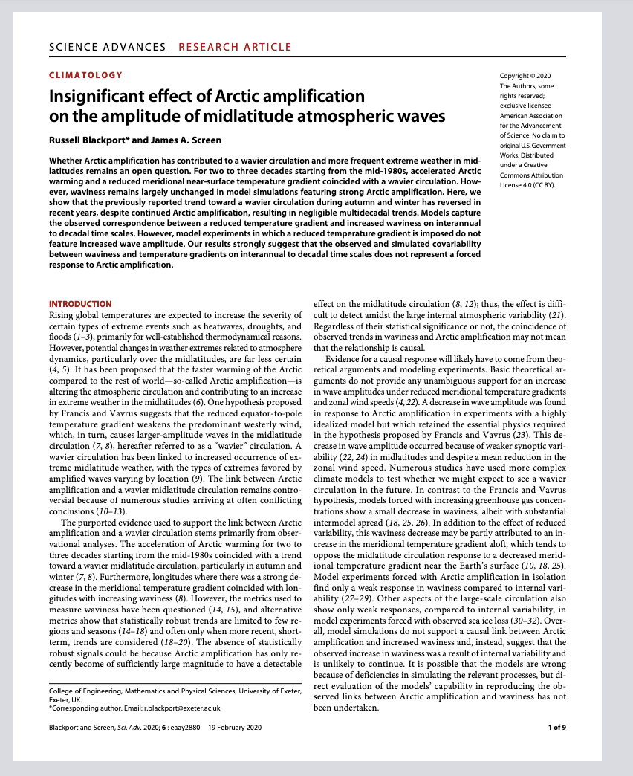

Hazard identification - Background information – Risk assessment – Relevant regulation - Recommendations
Influence of climate change :
-could increase cold wave frequency events
(Linking Arctic variability and change with extreme winter weather in the United States, Cohen et al., 2021)
Notes:
ADELE
Yet, with the Arctic warming three times faster than the average for rest of the world, the temperature difference between North and South decreases and so does the speed of the jet stream’s westerly winds. As these winds slow down, its waves typically grow bigger and extend farther to the North and the South. Larger jet-stream waves move eastward more slowly, affecting weather patterns across North America to Central Europe and Asia.
Climate change is favorable for increasing Arctic polar vortex stretching events, according to the study.

Slide 20
Risk assessment
Notes:
LEO

Slide 21
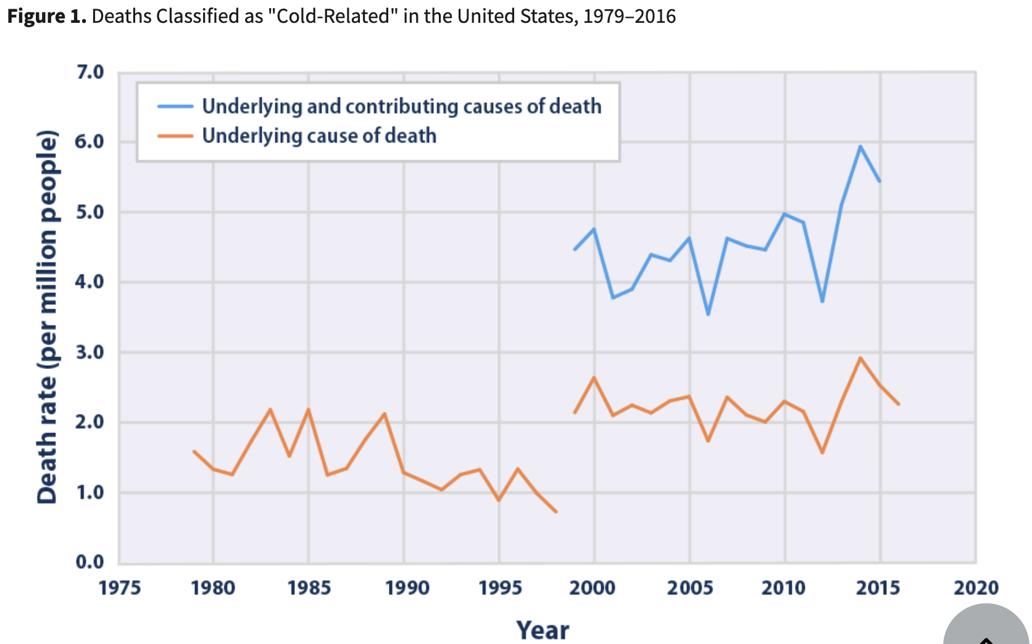
Background information – Hazard identification – Risk assessment – Relevant regulation - Recommandations
C'est pour toi leo : étude sur évolution morts par le froid , on voit pas que ça diminue avec le réchauffement climatique
Source : https://www.epa.gov/climate-indicators/climate-change-indicators-cold-related-deaths#ref1
Image : Mathew Barlow/University of Massachusetts Lowell, CC BY-ND

Slide 22
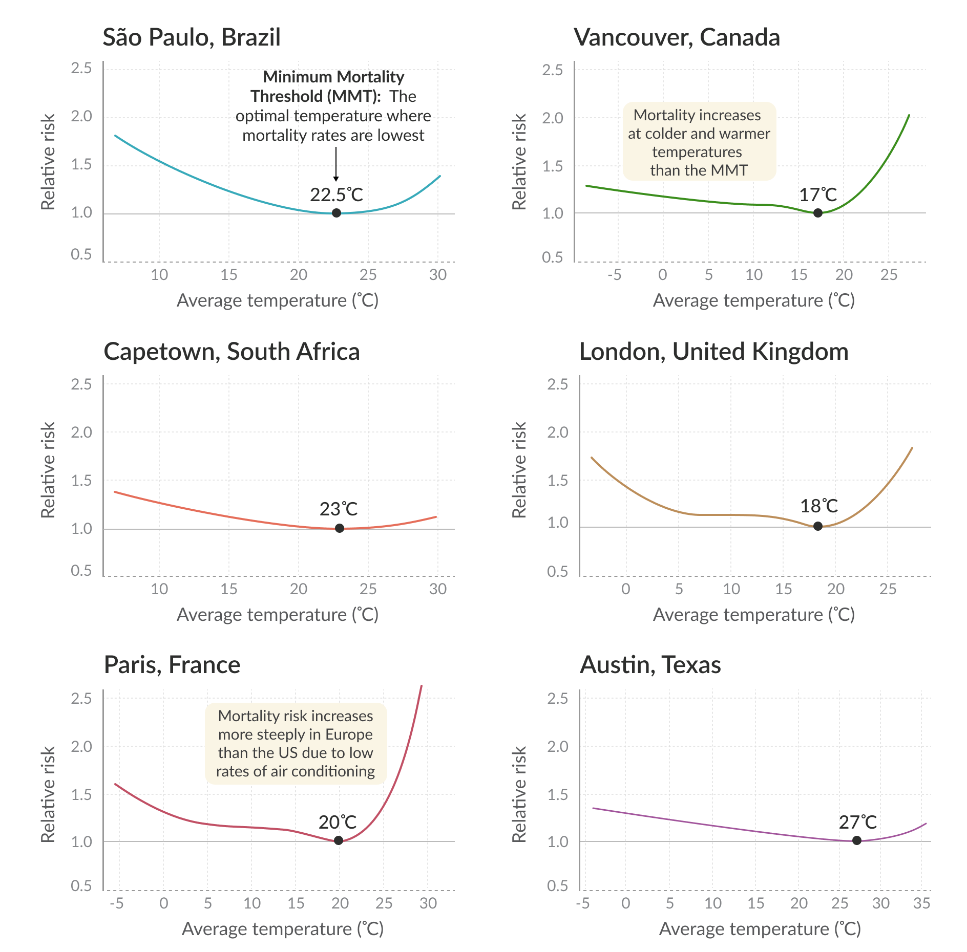
Hazard identification - Background information – Risk assessment – Relevant regulation - Recommendations
Cold waves, high or low risk ?
Depends on the region because of acclimatation and adaptation of the population
Hannah Ritchie (2024)
Notes:
LEO

Slide 23
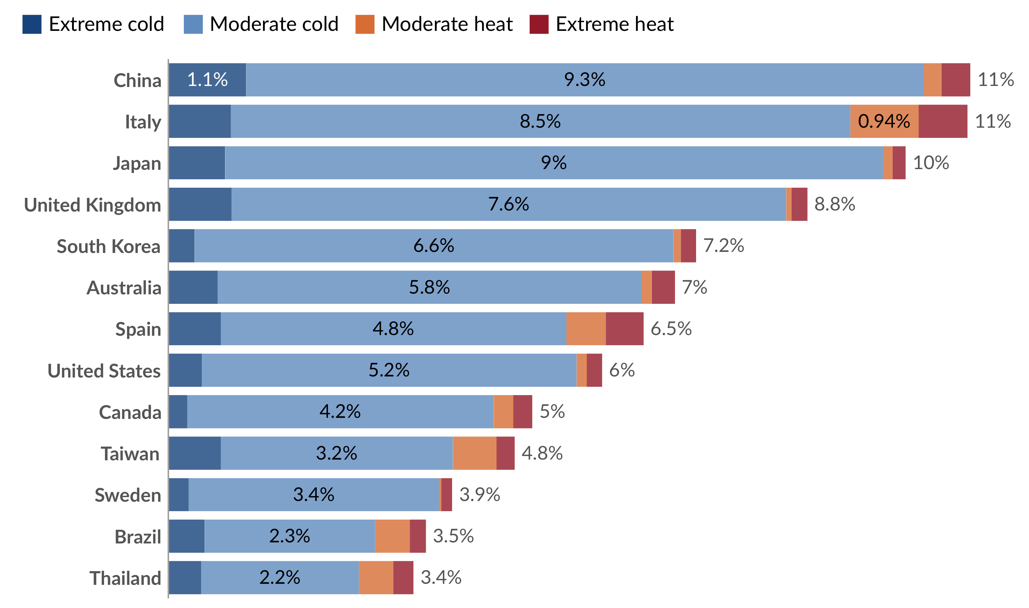
Hazard identification - Background information – Risk assessment – Relevant regulation - Recommendations
Death by cold and hot waves
Most cold-related deaths happen in moderate conditions
➔ risk is smaller but most time spent in these conditions
Total death toll
1.7 to 5 million deaths related to cold and heat every year globally
(Hannah Ritchie, 2024)
Share of deaths from all causes attributed to cold or heat, 2015
Gasparrini et al. (2015)
Notes:
LEO

Slide 24
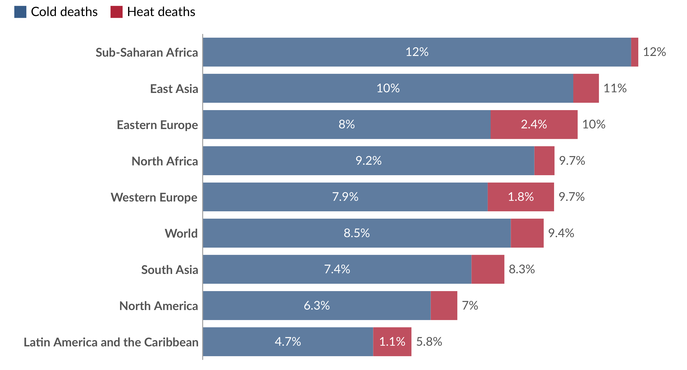
Hazard identification - Background information – Risk assessment – Relevant regulation - Recommendations
Share of all deaths attributed to sub-optimal temperatures (2000-2019)
Death by cold and hot waves
Cold-related death are more important than heat-related death (about 9 times higher)
About the same importance of cold vs. heat-related death in Europe (Masselot et al. 2023) and in the U.S.(Lee et al. 2023).
Zhao et al. (2021)
Notes:
LEO

Slide 25
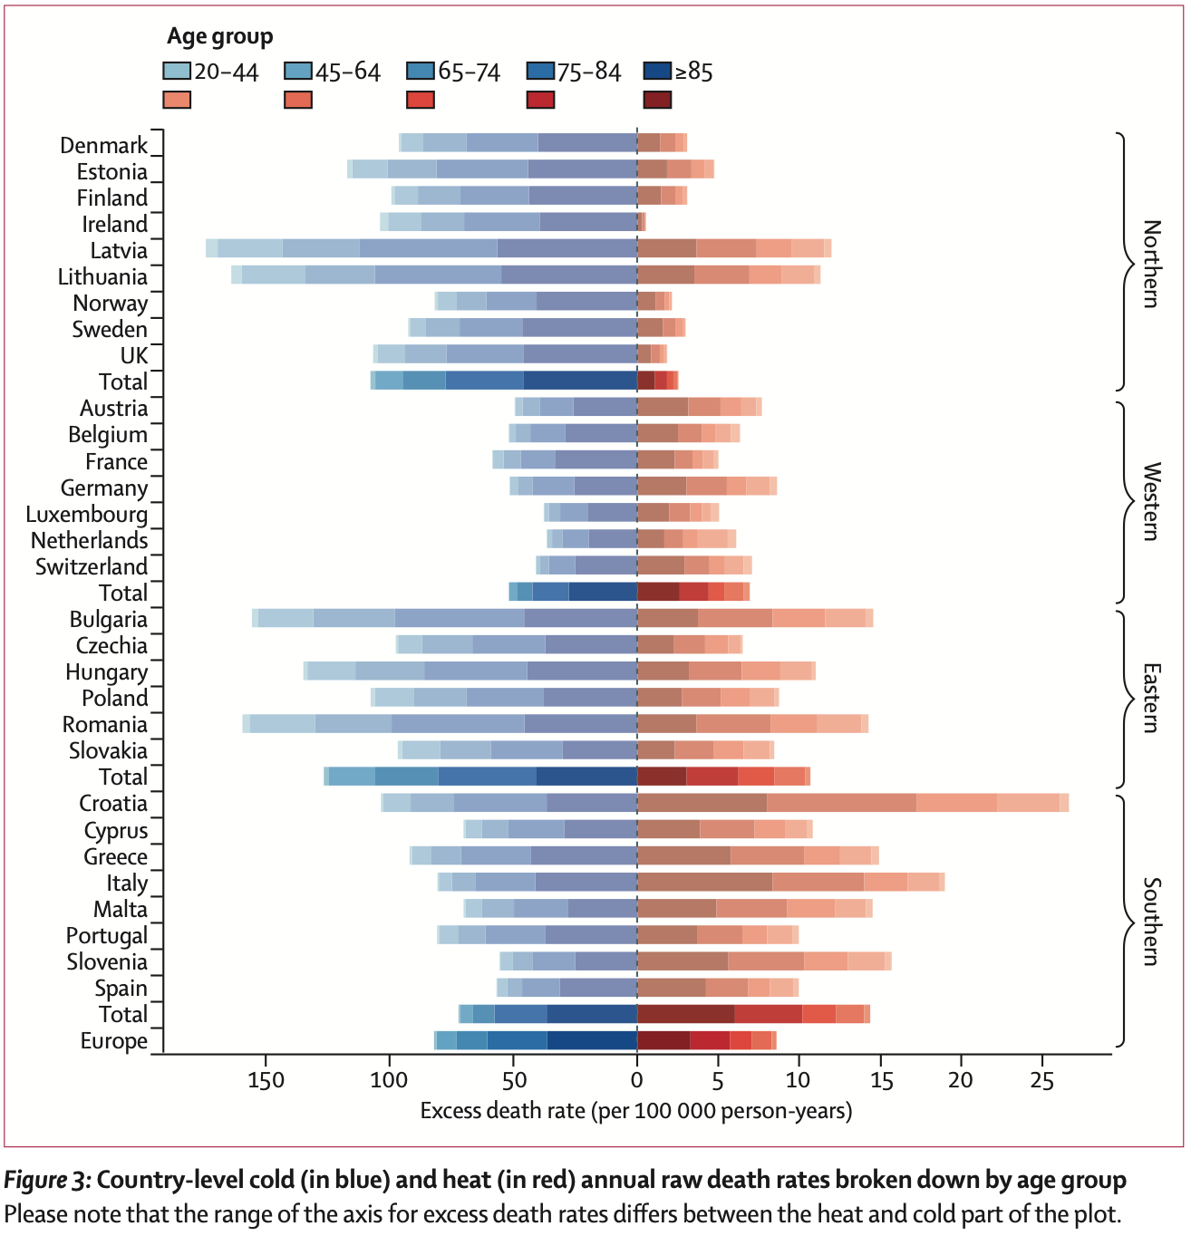
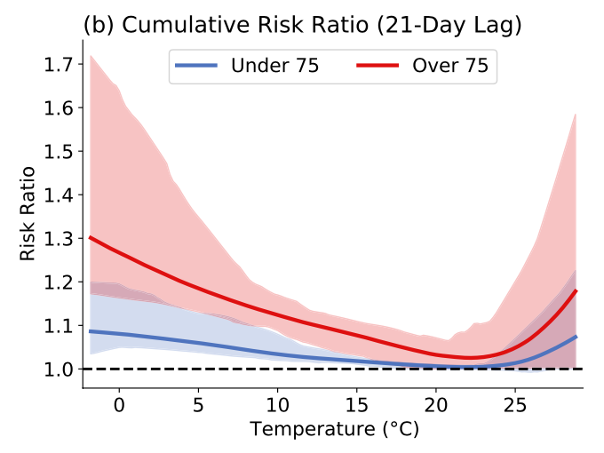
Hazard identification - Background information – Risk assessment – Relevant regulation - Recommendations
Most vulnerable population groups
The most at-risk population group regarding cold waves is the elderly
Children and people with chronic diseases are also at risk
Precarity can also lead to higher risk
heating/cooling shutdown
access to health centers
(Jessel et al. 2019)
In the U.S.
Risk ratio of under/over 75 age groups
(Lee et al. 2023)
Death rates related to cold and heat by age (Masselot et al. 2023)
In Europe
Notes:
LEO

Slide 26
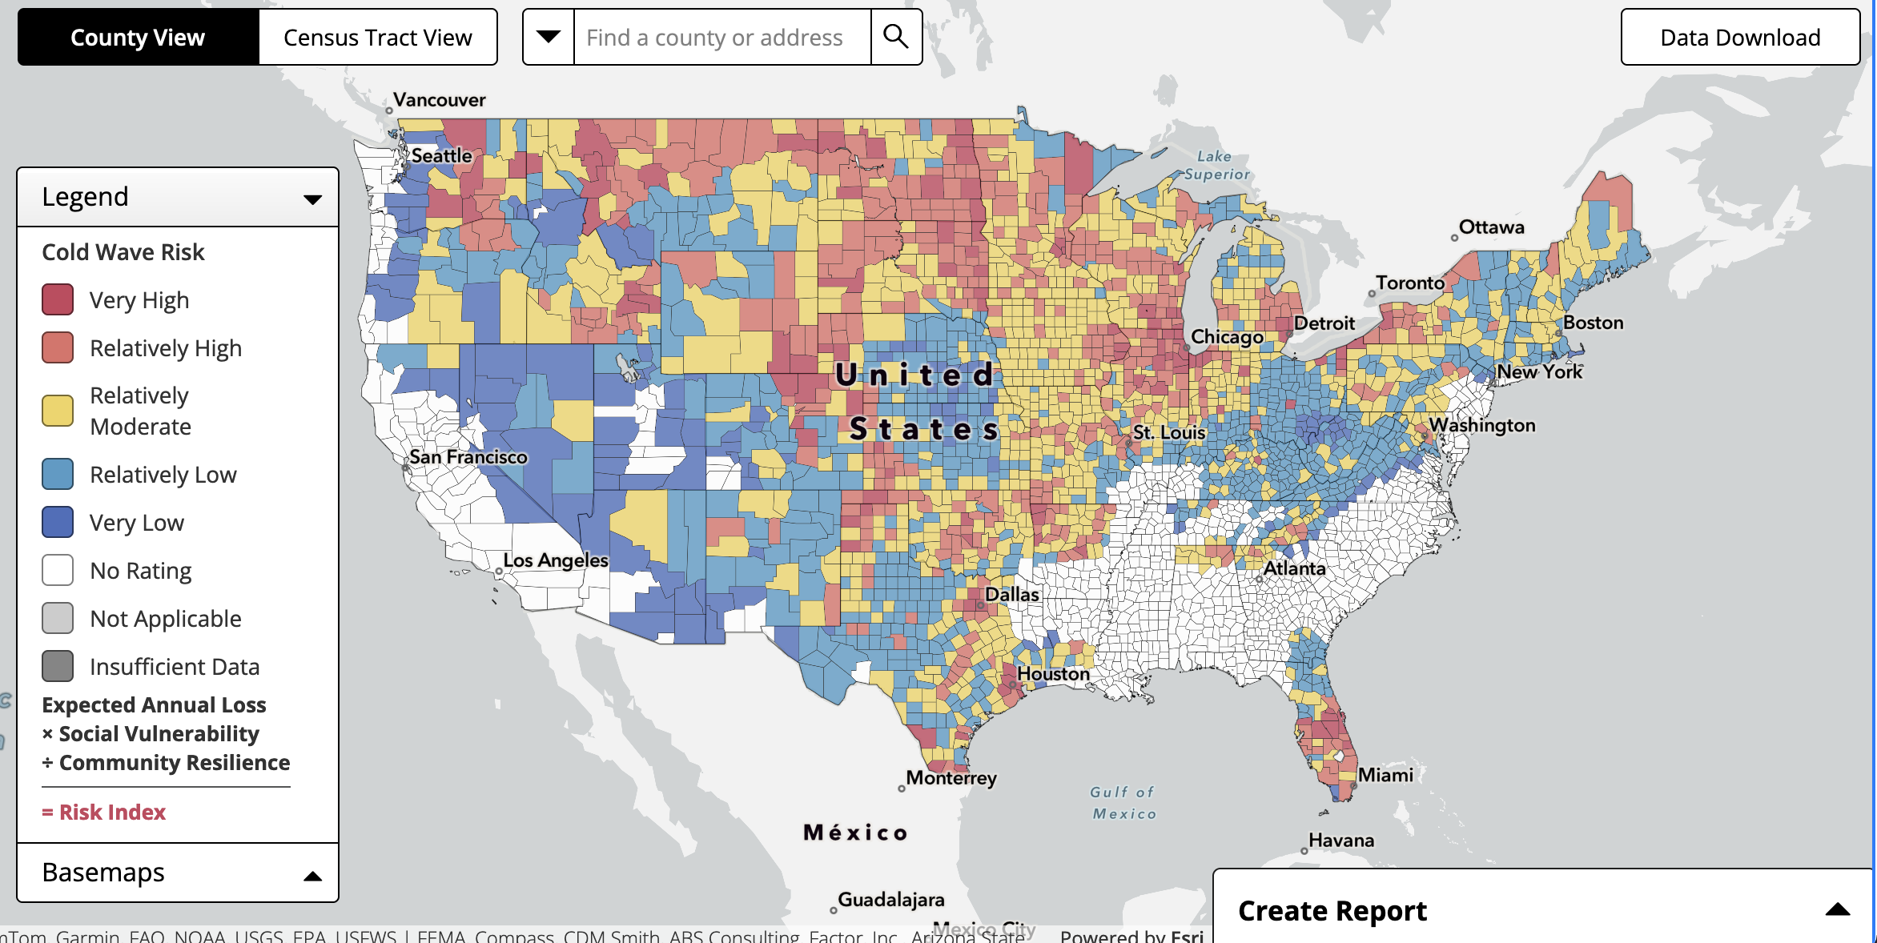
Hazard identification - Background information – Risk assessment – Relevant regulation - Recommendations
https://hazards.fema.gov/nri/map
Notes:
ADELE

Slide 27
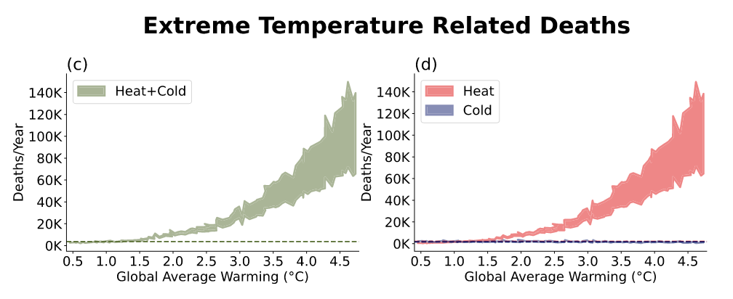
Hazard identification - Background information – Risk assessment – Relevant regulation - Recommendations
Cold waves related death evolution ?
Due to decrease (heat-related death increases)
Mortality shifts from South to North
(Northern cities less adapted to heat)
Cold waves related death evolution in the U.S.
(Lee et al. 2023)
Notes:
LEO

Slide 28
Relevant Regulations

Slide 29
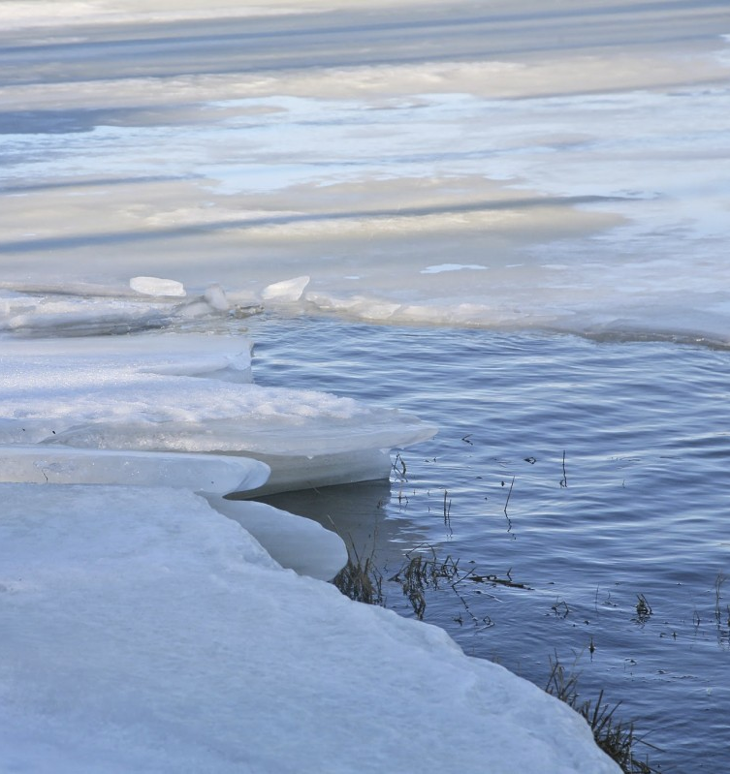
Paris Agreement
An international treaty under the United Nations Framework Convention on Climate Change (UNFCCC), aiming to limit global warming to well below 2°C above pre-industrial levels. It emphasizes enhancing adaptive capacity and resilience to climate-related hazards, including extreme cold events. (United Nations Framework Convention on Climate Change [UNFCCC], 2015)
World Health Organization (WHO) Cold Wave Guidelines
Provides checklists for assessing vulnerabilities in healthcare facilities during cold waves, emphasizing risk assessments, infrastructure preparedness, and emergency response plans. (World Health Organization [WHO], 2021)
European Union Climate Adaptation Strategy
Aims to make Europe climate-resilient by improving preparedness and response to climate impacts, including extreme cold events, through comprehensive risk assessments and adaptation planning. (European Commission, 2021)
Image: Pxhere. (n.d.). Ice-covered water and broken ice formations [Photograph]

Slide 30
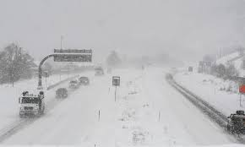
India: National Guidelines for Preparation of Action Plan – Prevention and Management of Cold Wave and Frost
These guidelines provide a framework for state and local governments to develop action plan on early warning systems, public awareness campaigns, and community preparedness measures to mitigate the adverse effects of extreme cold weather. (National Disaster Management Authority [NDMA], 2021)
Geneva, Switzerland: The Cantonal climate plan 2030 - 2nd generation
It is Geneva’s strategic framework to combat climate change. It focuses on building resilience to extreme weather events through sustainable infrastructure, energy efficiency, and community preparedness, ensuring a comprehensive response to climate challenges. (République et canton de Genève, 2023)
Minnesota, USA: Cold Weather Rule (CWR)
Minnesota’s Cold Weather Rule (CWR) is a state law that protects residential utility customers from having electric or natural gas service shut off between October 1 and April 30. (Minnesota Office of the Revisor of Statutes, 2024)
Image: Associated Press. (2020, February 9). Heavy snowfall leaves an inter-state highway snow-packed as drivers make their way through Glenwood Springs, Colorado [Photograph]. Dawn.

Slide 31
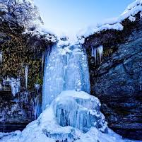
Specific Regulations
Power grid
United States: Federal Energy Regulatory Commission (FERC) Orders to Enhance Grid Reliability in Extreme Weather Conditions
Rule RM22-10: Directs the North American Electric Reliability Corporation (NERC) to develop new or modified reliability standards requiring transmission system planning for extreme weather, including the impact of concurrent failures of generation and transmission equipment, with corrective actions implemented.
Rule RM22-16 / AD21-13: Requires transmission providers to submit reports on their policies and processes for conducting extreme weather vulnerability assessments and to identify mitigation strategies for improving grid resilience. (Federal Energy Regulatory Commission [FERC], 2023)
Building safety
Eurocode 1: Actions on Structures – Part 1-3: General Actions – Snow Loads (EN 1991-1-3)
Provides guidelines for determining snow loads on structures, essential for designing buildings capable of withstanding heavy snowfall and preventing structural failures during cold waves. (European Committee for Standardization [CEN], 2003)
International Building Code (IBC) Insulation Requirements
The IBC outlines the amount and quality of insulation required for buildings based on their geographical locations. These requirements are crucial for maintaining energy efficiency and indoor comfort during cold waves. (International Code Council [ICC], 2021)
Image: Reddit User. (2024). Record cold in Argentina as cold wave from Antarctica strikes [Photograph]

Slide 32
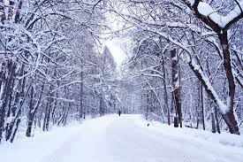
Occupational Safety
USA: OSHA Winter Weather Guidelines
The Occupational Safety and Health Administration (OSHA) provides guidelines to protect workers from cold stress during extreme cold conditions, including recommendations on proper clothing, safe work practices, and training to recognize cold-related illnesses. (Occupational Safety and Health Administration [OSHA], 1970)
Traffic Regulations
Austria: Winter Tire and Snow Chain Regulation
In Austria, winter tires are mandatory for all vehicles from November 1 to April 15. Vehicles must be equipped with winter tires marked M+S and/or Alpine symbol (3PMSF) on at least one drive axle with a minimum tread depth of 5 mm (radial). Additionally, snow chains must be carried in the vehicle for at least two drive axle tires during this period. (Kraftfahrgesetz [KFG], 1967; Kraftfahrgesetz-Durchführungsverordnung [KDV], 1967)
Geological Safety
Switzerland’s Federal Office for the Environment (FOEN) Guidelines on Natural Hazards: Protection against Mass Movement Hazards (2016), Defense Structures in Avalanche Starting Zones (2007), Spatial Planning and Natural Hazards (2005)
They provides comprehensive guidelines to manage natural hazards, including avalanches and landslides. These enforcement aids offer technical guidance on hazard assessment, risk management, and protective measures to mitigate geological risks during extreme cold events.
Image: Man Walking on a Road During Cold Wave: India Weather Blog (2019)

Slide 33
Recommendations

Slide 34

For individual:
Stay informed of weather updates from official sources
Dress appropriately with sufficient warm clothing including insulated warm outwear, gloves, hat and waterproof boots.
Keep essential items like foods, water, flashlight, batteries, and blankets in case of power outages.
Prepare essential and cold-related illness medicines at home
Regularly check on vulnerable populations like the elderly, children, and individuals of chronic diseases.
Image: Eli Lilly and Company. (n.d.). Be ready. Be prepared. [Image].

Slide 35

For government agencies:
Develop cold wave action plans to coordinate responses across agencies
Enhance meteorological monitoring and issue timely alerts
Ensure power grids are winterized and prepared for increase demand during cold wave
Prepare and set up temporary shelters to provide warmth and protection for people in need
Ensure healthcare systems are prepared for cold-related illness treatment
Make regulations for house owners or management companies to regularly inspect and maintain HVAC system to ensure uninterrupted heating during cold wave
Provide subsidies and support for heating cost to low-income households
Freepik. (n.d.). Get ready icon design template [Vector image]

Slide 36
References
Hannah Ritchie (2024) - “How many people die from extreme temperatures, and how this could change in the future: Part one” Published online at OurWorldinData.org. Retrieved from: 'https://ourworldindata.org/part-one-how-many-people-die-from-extreme-temperatures-and-how-could-this-change-in-the-future' [Online Resource]
Gasparrini et al. (2015). Mortality risk attributable to high and low ambient temperature: a multicountry observational study.
Zhao et al. (2021). Global, regional, and national burden of mortality associated with non-optimal ambient temperatures from 2000 to 2019: a three-stage modelling study
Lee, Jangho, and Andrew E. Dessler. ‘Future Temperature‐Related Deaths in the U.S.: The Impact of Climate Change, Demographics, and Adaptation’. GeoHealth 7, no. 8 (August 2023): e2023GH000799. https://doi.org/10.1029/2023GH000799.
Masselot, Pierre, Malcolm Mistry, Jacopo Vanoli, Rochelle Schneider, Tamara Iungman, David Garcia-Leon, Juan-Carlos Ciscar, et al. ‘Excess Mortality Attributed to Heat and Cold: A Health Impact Assessment Study in 854 Cities in Europe’. The Lancet Planetary Health 7, no. 4 (April 2023): e271–81. https://doi.org/10.1016/S2542-5196(23)00023-2.
Jessel, Sonal, Samantha Sawyer, and Diana Hernández. ‘Energy, Poverty, and Health in Climate Change: A Comprehensive Review of an Emerging Literature’. Frontiers in Public Health 7 (12 December 2019): 357. https://doi.org/10.3389/fpubh.2019.00357.
United Nations Framework Convention on Climate Change (UNFCCC). (2015). The Paris Agreement. Retrieved from https://unfccc.int
World Health Organization (WHO). (2021). Cold wave preparedness guidelines: Checklists for healthcare facilities. Retrieved from https://cdn.who.int
European Commission. (2021). EU strategy on adaptation to climate change. Retrieved from https://ec.europa.eu
National Disaster Management Authority (NDMA). (2021). National Guidelines for Preparation of Action Plan – Prevention and Management of Cold Wave and Frost. Retrieved from https://ndma.gov.in/Governance/Guidelines

Slide 37
République et canton de Genève. (2023). Plan Climat Cantonal 2030: 2e Génération. Retrieved from https://www.ge.ch/document/plan-climat-cantonal-2030-2e-generation-0
Minnesota Office of the Revisor of Statutes. (2024). Minnesota Statutes 2024, Section 216B.096: Cold Weather Rule; Public Utility. Retrieved from https://www.revisor.mn.gov/statutes/cite/216b.096
National Disaster Management Authority (NDMA). (2021). National Guidelines for Preparation of Action Plan – Prevention and Management of Cold Wave and Frost. Retrieved from https://ndma.gov.in/Governance/Guidelines
Federal Emergency Management Agency (FEMA). (2023). Guidance on extreme temperatures for state, local, tribal, and territorial leaders. Retrieved from https://www.fema.gov/sites/default/files/documents/fema_guidance-extreme-temperatures-state-local-tribal-territorial-leaders.pdf
République et canton de Genève. (2023). Plan Climat Cantonal 2030: 2e Génération. Retrieved from https://www.ge.ch/document/plan-climat-cantonal-2030-2e-generation-0
Minnesota Office of the Revisor of Statutes. (2024). Minnesota Statutes 2024, Section 216B.096: Cold Weather Rule; Public Utility. Retrieved from https://www.revisor.mn.gov/statutes/cite/216b.096
Occupational Safety and Health Administration (OSHA). (1970). Occupational Safety and Health Act of 1970 (Section 5(a)(1)). Retrieved from https://www.osha.gov/laws-regs/oshact/completeoshact
Republic of Austria. (1967). Kraftfahrgesetz 1967 (KFG): Motor Vehicle Act. BGBl. Nr. 267/1967. Retrieved from https://www.ris.bka.gv.at
Republic of Austria. (1967). Kraftfahrgesetz-Durchführungsverordnung 1967 (KDV): Motor Vehicle Act Implementing Regulation. BGBl. Nr. 399/1967. Retrieved from https://www.ris.bka.gv.at
Federal Office for the Environment (FOEN). (2016). Protection against mass movement hazards: Guideline for the integrated hazard management of landslides, rockfall, and hillslope debris flows. Retrieved from https://www.bafu.admin.ch/bafu/en/home/topics/natural-hazards/publications-studies/publications/protection-against-mass-movement-hazards.html
Federal Office for the Environment (FOEN). (2007). Defense structures in avalanche starting zones: Technical guideline as an aid to enforcement. Retrieved from https://www.bafu.admin.ch/bafu/en/home/topics/natural-hazards/publications-studies/publications/defense-structures-in-avalanche-starting-zones.html
Federal Office for the Environment (FOEN). (2005). Spatial planning and natural hazards: Recommendations. Retrieved from https://www.bafu.admin.ch/bafu/en/home/topics/natural-hazards/publications-studies/publications/spatial-planning-and-natural-hazards.html

Slide 38

Any questions ?

